Slide 1
PCL Keypoints and Features
Mouqing Jin
04/23/2018
Multimedia Computing & Communication Lab

Slide 2
3D Keypoint Detection
Fixed-Scale Keypoint Detection(predetermined neighborhood)
Curvature based methods
Surface Variation measure based methods
Adaptive-Scale Keypoint Detection(scale-space)
Coordinate smoothing based methods
Geometric attribute smoothing based methods
Surface variation based methods
Transform based methods
Multimedia Computing & Communication Lab

Slide 3




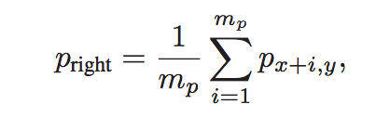

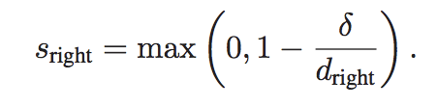
NARF (border extraction)
employ a heuristic to find the typical 3D distance to neighboring points that are not across a border
For each point P_{i} select all the neighboring points in s²:
Calculate their 3D distance :
Set it in increasing order:
Set the s =5 and M=9 typical distance to pi-s neighbors：
use this information to calculate a score for how likely it is that this point is part of a border (top, left, right, or bottom)
calculate the average 3D position of m_{p} = 3 neighbors on the right:
calculate the 3D distance:
calculate a score based on the quotient of d_{right} and δ :
Multimedia Computing & Communication Lab

Slide 4

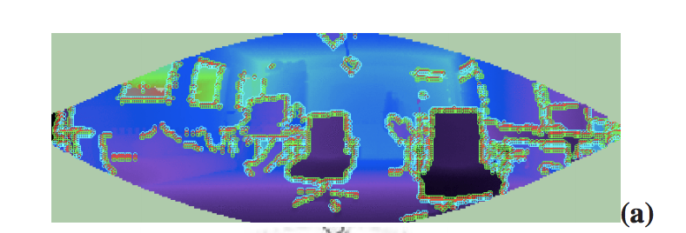
NARF (border extraction)
identify the class to which this border point belongs, and perform non-maximum suppression to find the exact border position.
selecting the one with the highest score in a maximum 2D distance as a corresponding shadow border s_{shadow}
slightly decrease s_{right} up to 10%
check if s ′ _{right} is above a threshold (0.8 ) and if it is a maximum regarding p_{x−1,y} and p_{x+1,y}
Multimedia Computing & Communication Lab

Slide 5
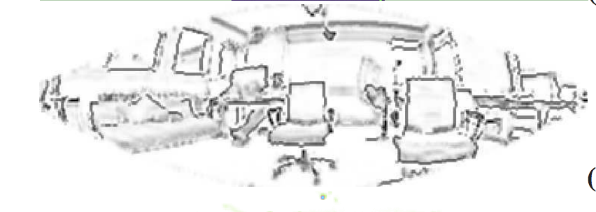
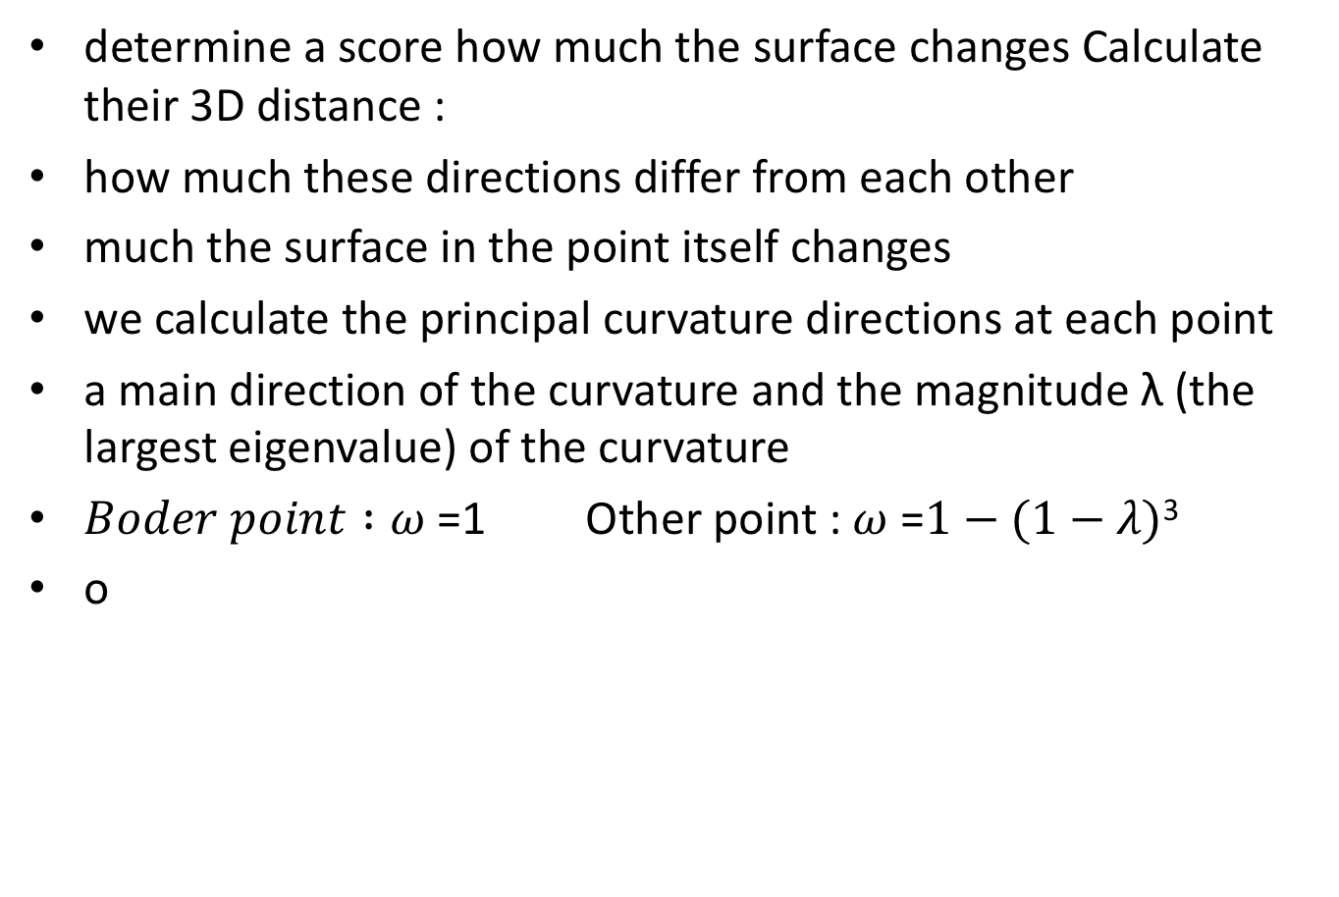
NARF (interest point extraction)
determine a score how much the surface changes Calculate their 3D distance :
how much these directions differ from each other
much the surface in the point itself changes
we calculate the principal curvature directions at each point
a main direction of the curvature and the magnitude λ (the largest eigenvalue) of the curvature
$Boder point :ω$ =1 Other point : $ω$ =$1−(1−λ)$³
o
Multimedia Computing & Communication Lab

Slide 6

NARF (interest point extraction)
$\text{Each} \text{of} \text{those} \text{points} \text{ni} \text{has} \text{a} \text{main} \text{direction} \text{vni} \text{and} \text{a} \text{weight} \text{wni}\text{ .}$
we project the directions onto a plane perpendicular to the direction from the sensor to p.
Multimedia Computing & Communication Lab

Slide 7
Unifor sampling
creates a 3D voxel grid (think about a voxel grid as a set of tiny 3D boxes in space) over the input point cloud data. Then, in each voxel (i.e., 3D box), all the points present will be approximated (i.e., downsampled) with their centroid. This approach is a bit slower than approximating them with the center of the voxel, but it represents the underlying surface more accurately.Surface normals are heavily used in many areas such as computer graphics applications and computer feature histogram.
Multimedia Computing & Communication Lab

Slide 8
Local Surface Feature Description
Signature based methods (NARF)
Histogram Based methods
Spatial distribution histogram (Spin Image)
Geometric attribute histogram (PFH, FPFH, SHOT)
Oriented gradient histogram
Transform Based Methods
Multimedia Computing & Communication Lab

Slide 9
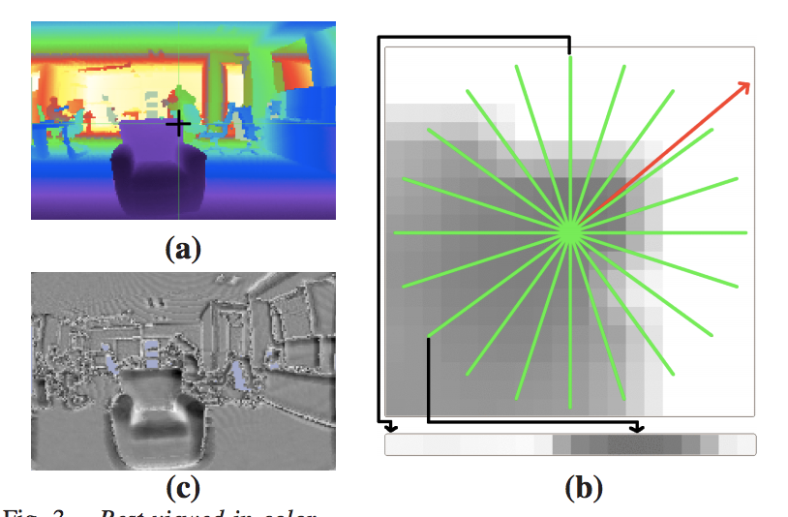
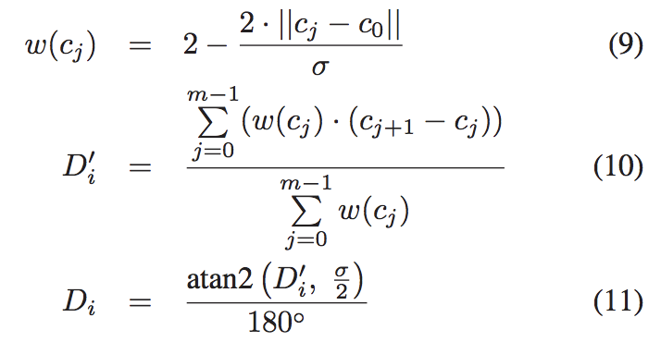
NARF
calculate a normal aligned range value patch in the point, which is a small range image with the observer looking at the point along the normal,
overlay a star pattern onto this patch, where each beam corresponds to a value in the final descriptor, that captures how much the pixels under the beam change
Multimedia Computing & Communication Lab

Slide 10
Spin Image
Main step:
Multimedia Computing & Communication Lab

Slide 11
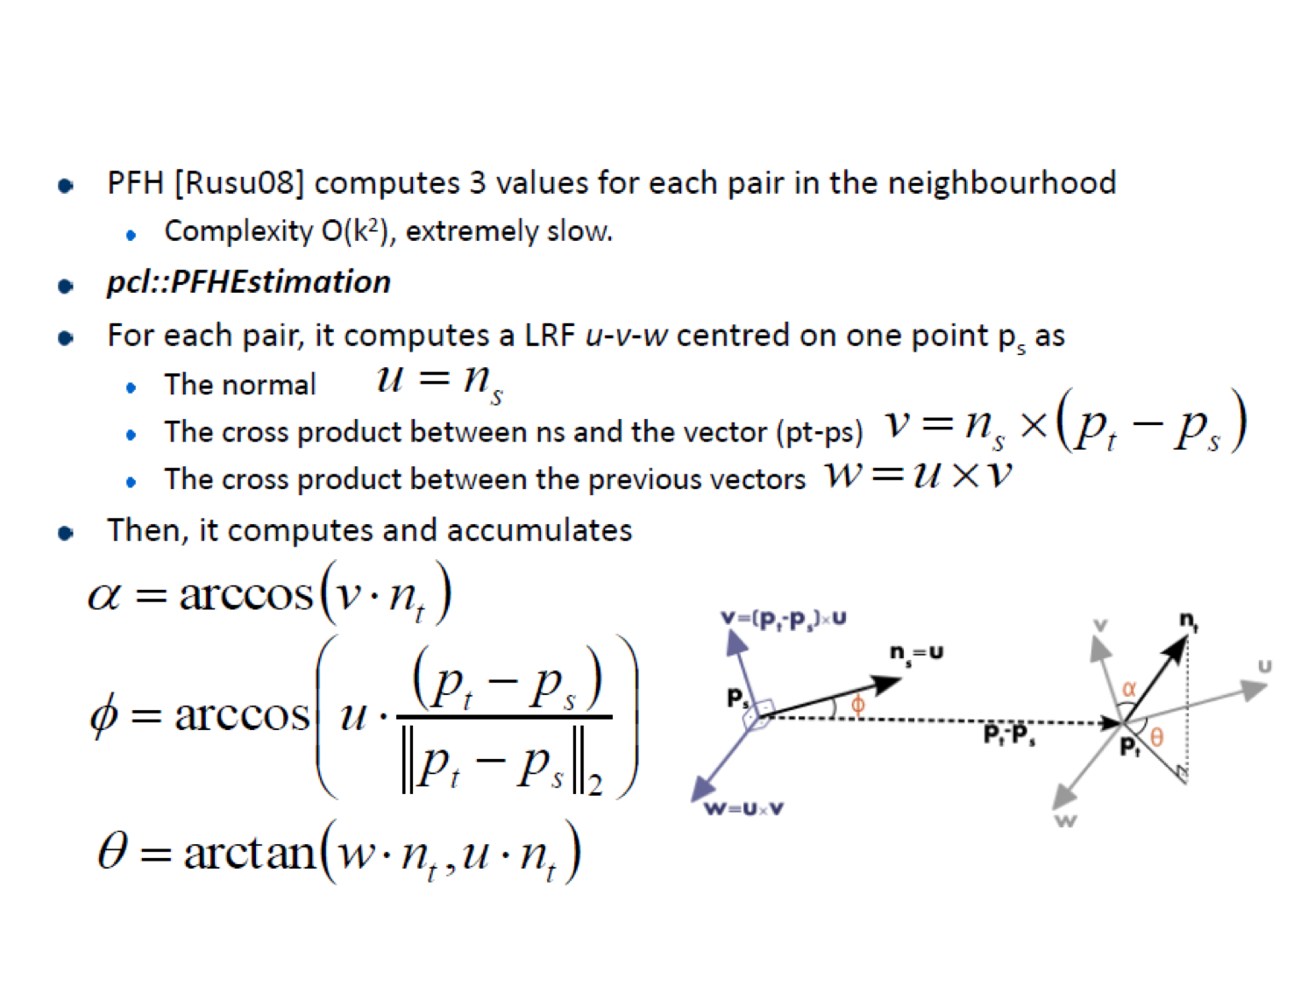
PFH
Main step:
Multimedia Computing & Communication Lab

Slide 12
SPFH
PFH Computation Complexity: O(nk²)
n : number of points
k : number of neighbors used
FPFH Computation Complexity: O(nk²)
Caching and Ordering (reduced runtime by 75%)
Simplified point Feature

Slide 13
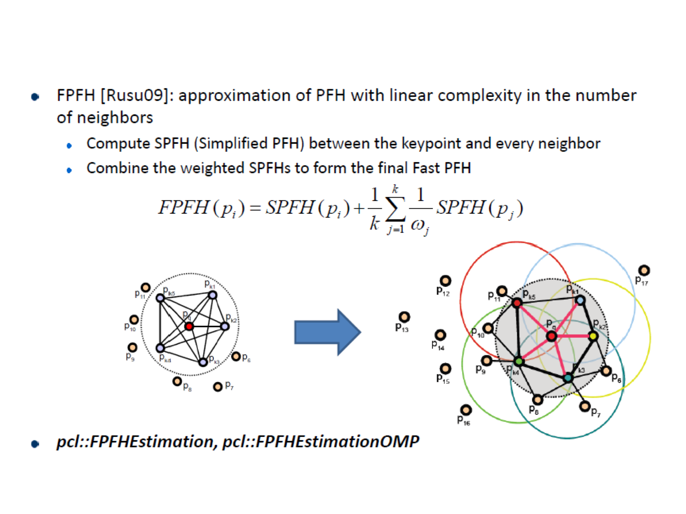
SPFH
Multimedia Computing & Communication Lab

Slide 14
SHOT
Main step:
Multimedia Computing & Communication Lab

Slide 15
Thank you!

